Slide 1
Part (2)
Inter-Symbol Interference due to multi-path channels

Slide 2
Transmitter “Generating the signal BPSK”
Generating Random Integer between (0&1).
Converting every 0 to -1.
l = 100; %No of paths
S = randi([0,1],L,1);
A=length(S);
for i= 1 : length(S)
if S(i) == 0
S(i)= -1;
end
end

Slide 3

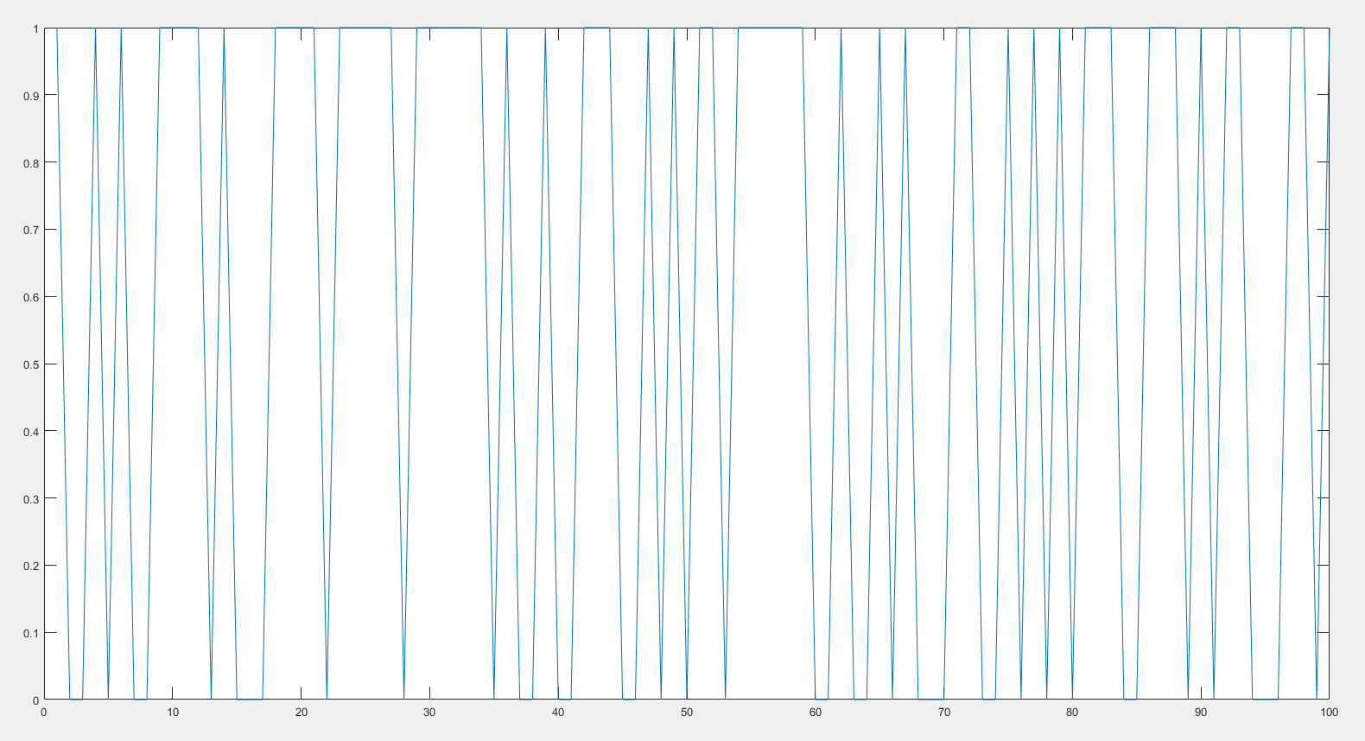
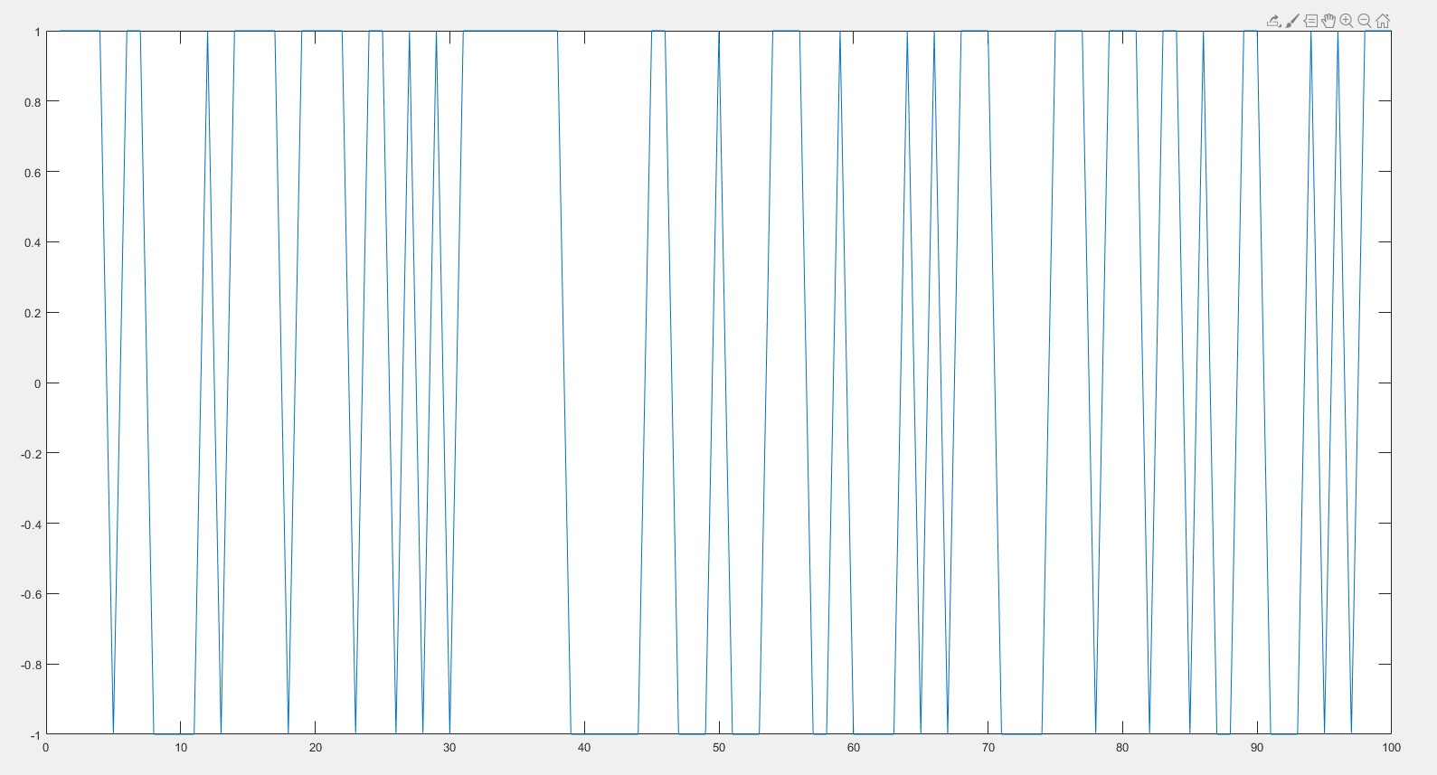

Slide 4
Channel “Due to Multipath Effect & noise”
Generating the coefficients due to the multipath effect.
Adding the noise to the system.
h = MultipathChannel(L,1);
H = tril(toeplitz(h));
V = H * S;
Eb_No_db = 0; % The specified Eb/No value in dB
Energy_per_bit = 1;
No = Energy_per_bit/( 10^(Eb_No_db/10));
noise= (randn(size(V)) + 1i*randn(size(V)))*sqrt(No/2); %generate Noise
Y = (H * S) + noise ; %getting the received signal Y

Slide 5
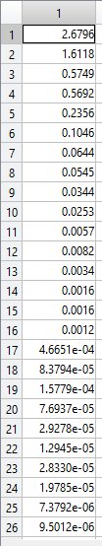
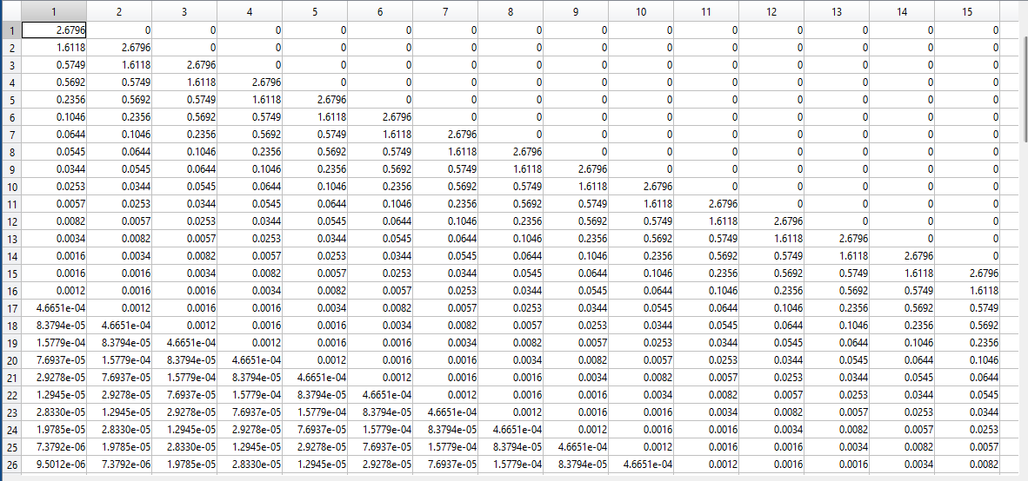

Slide 6
Estimating the output due to the channel effect
Taking the inverse of the input to the receiver.
Estimating the output of the signal if it is greater of “0” will be 1 if less than “0” will be -1.
Z= inv(H); %Equalize channel effect
X= Z * Y;
X_Estimated = zeros(l,1);
%Decision Maker
for i=1:length(S)
if X(i) > 0
B =1;
else
B=-1;
end
X_Estimated(i) = B; %Estimated_Transmitted_signal
end

Slide 7
Changing the power ratio and calculate the BER
Changing the power of the noise.
Each time we calculate the BER.

Slide 8
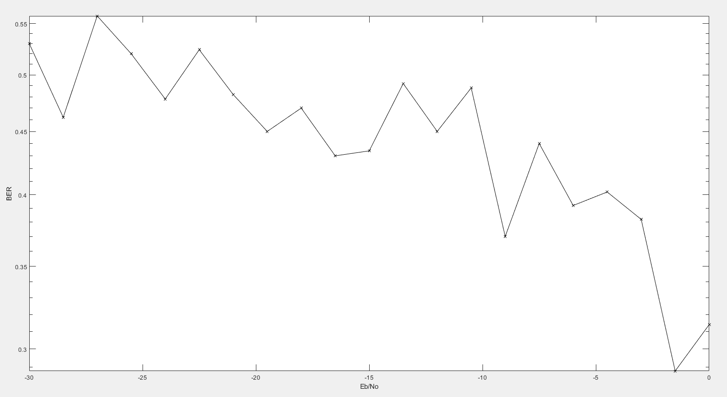

Slide 9
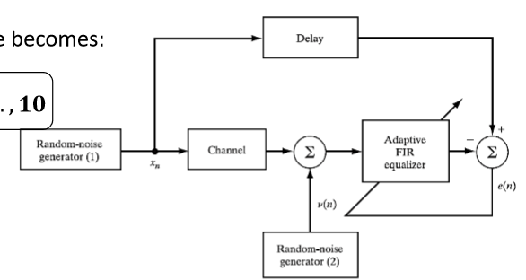
Another System to equalize the channel.
We can use the Adaptive Filters to generate the inverse of the channel.
We will use Weiner Solution.

Slide 10
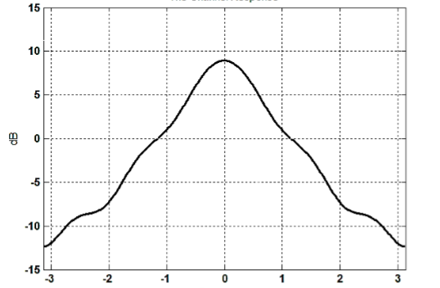
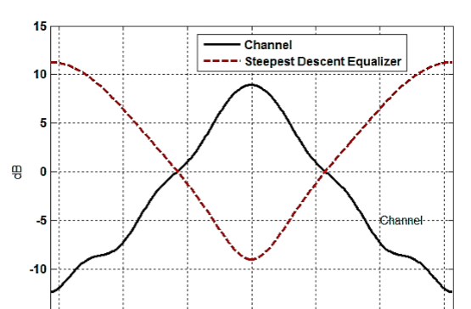
The idea behind the weiner:
If the input is like figure(1), the filter will try to get the inverse of the channel like figure (2).

